Slide 1
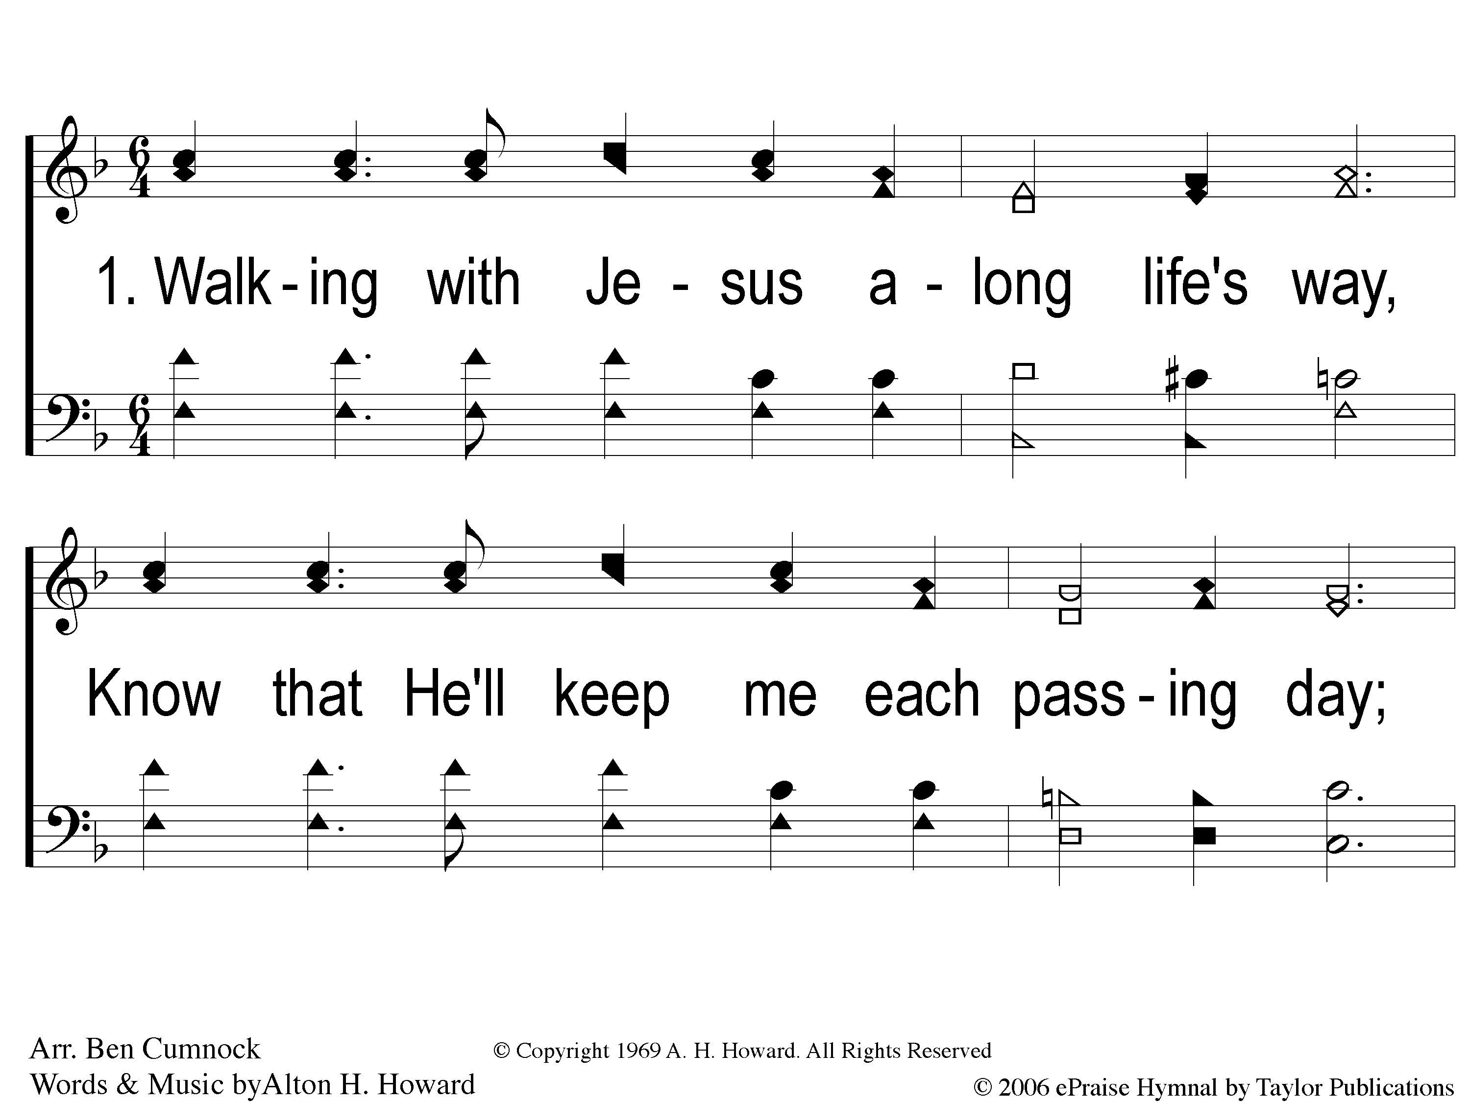
1-1 Tell Them of Jesus
Tell Them of Jesus
1a

Slide 2
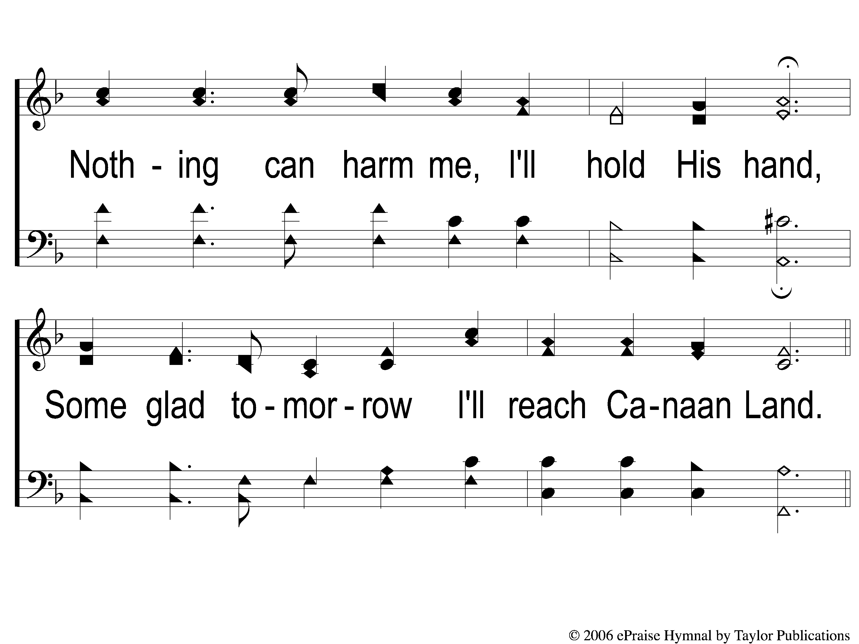
1-2 Tell Them of Jesus
Tell Them of Jesus
1a

Slide 3
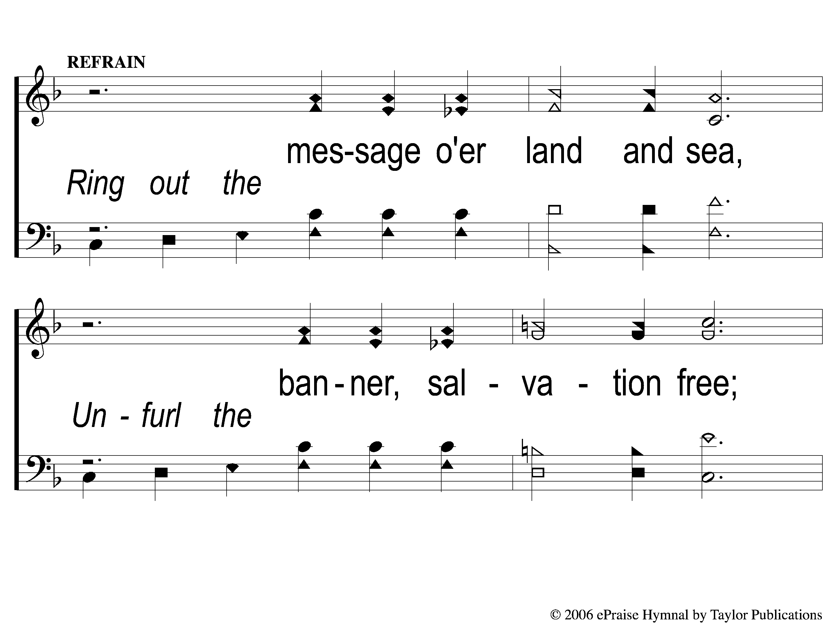
C-1 Tell Them of Jesus
Tell Them of Jesus
1a

Slide 4
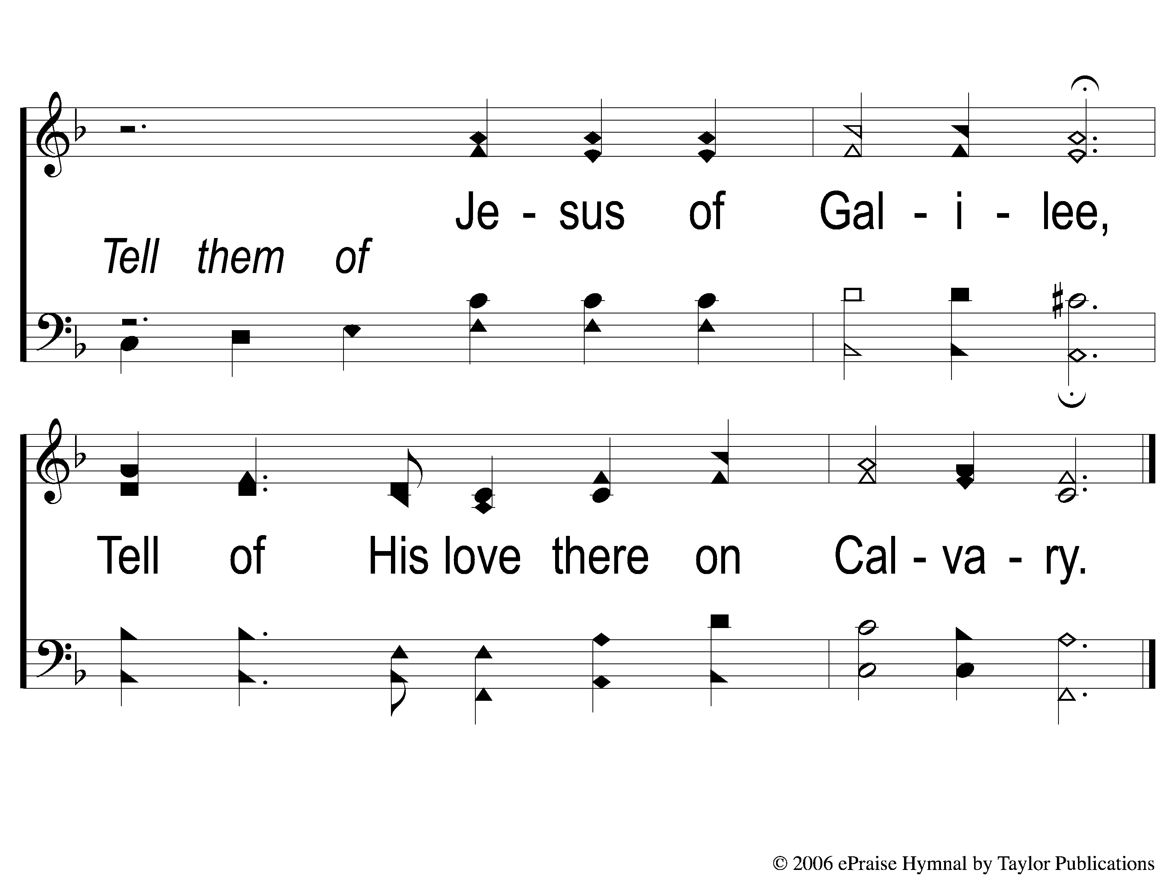
C-2 Tell Them of Jesus
Tell Them of Jesus
1a

Slide 5
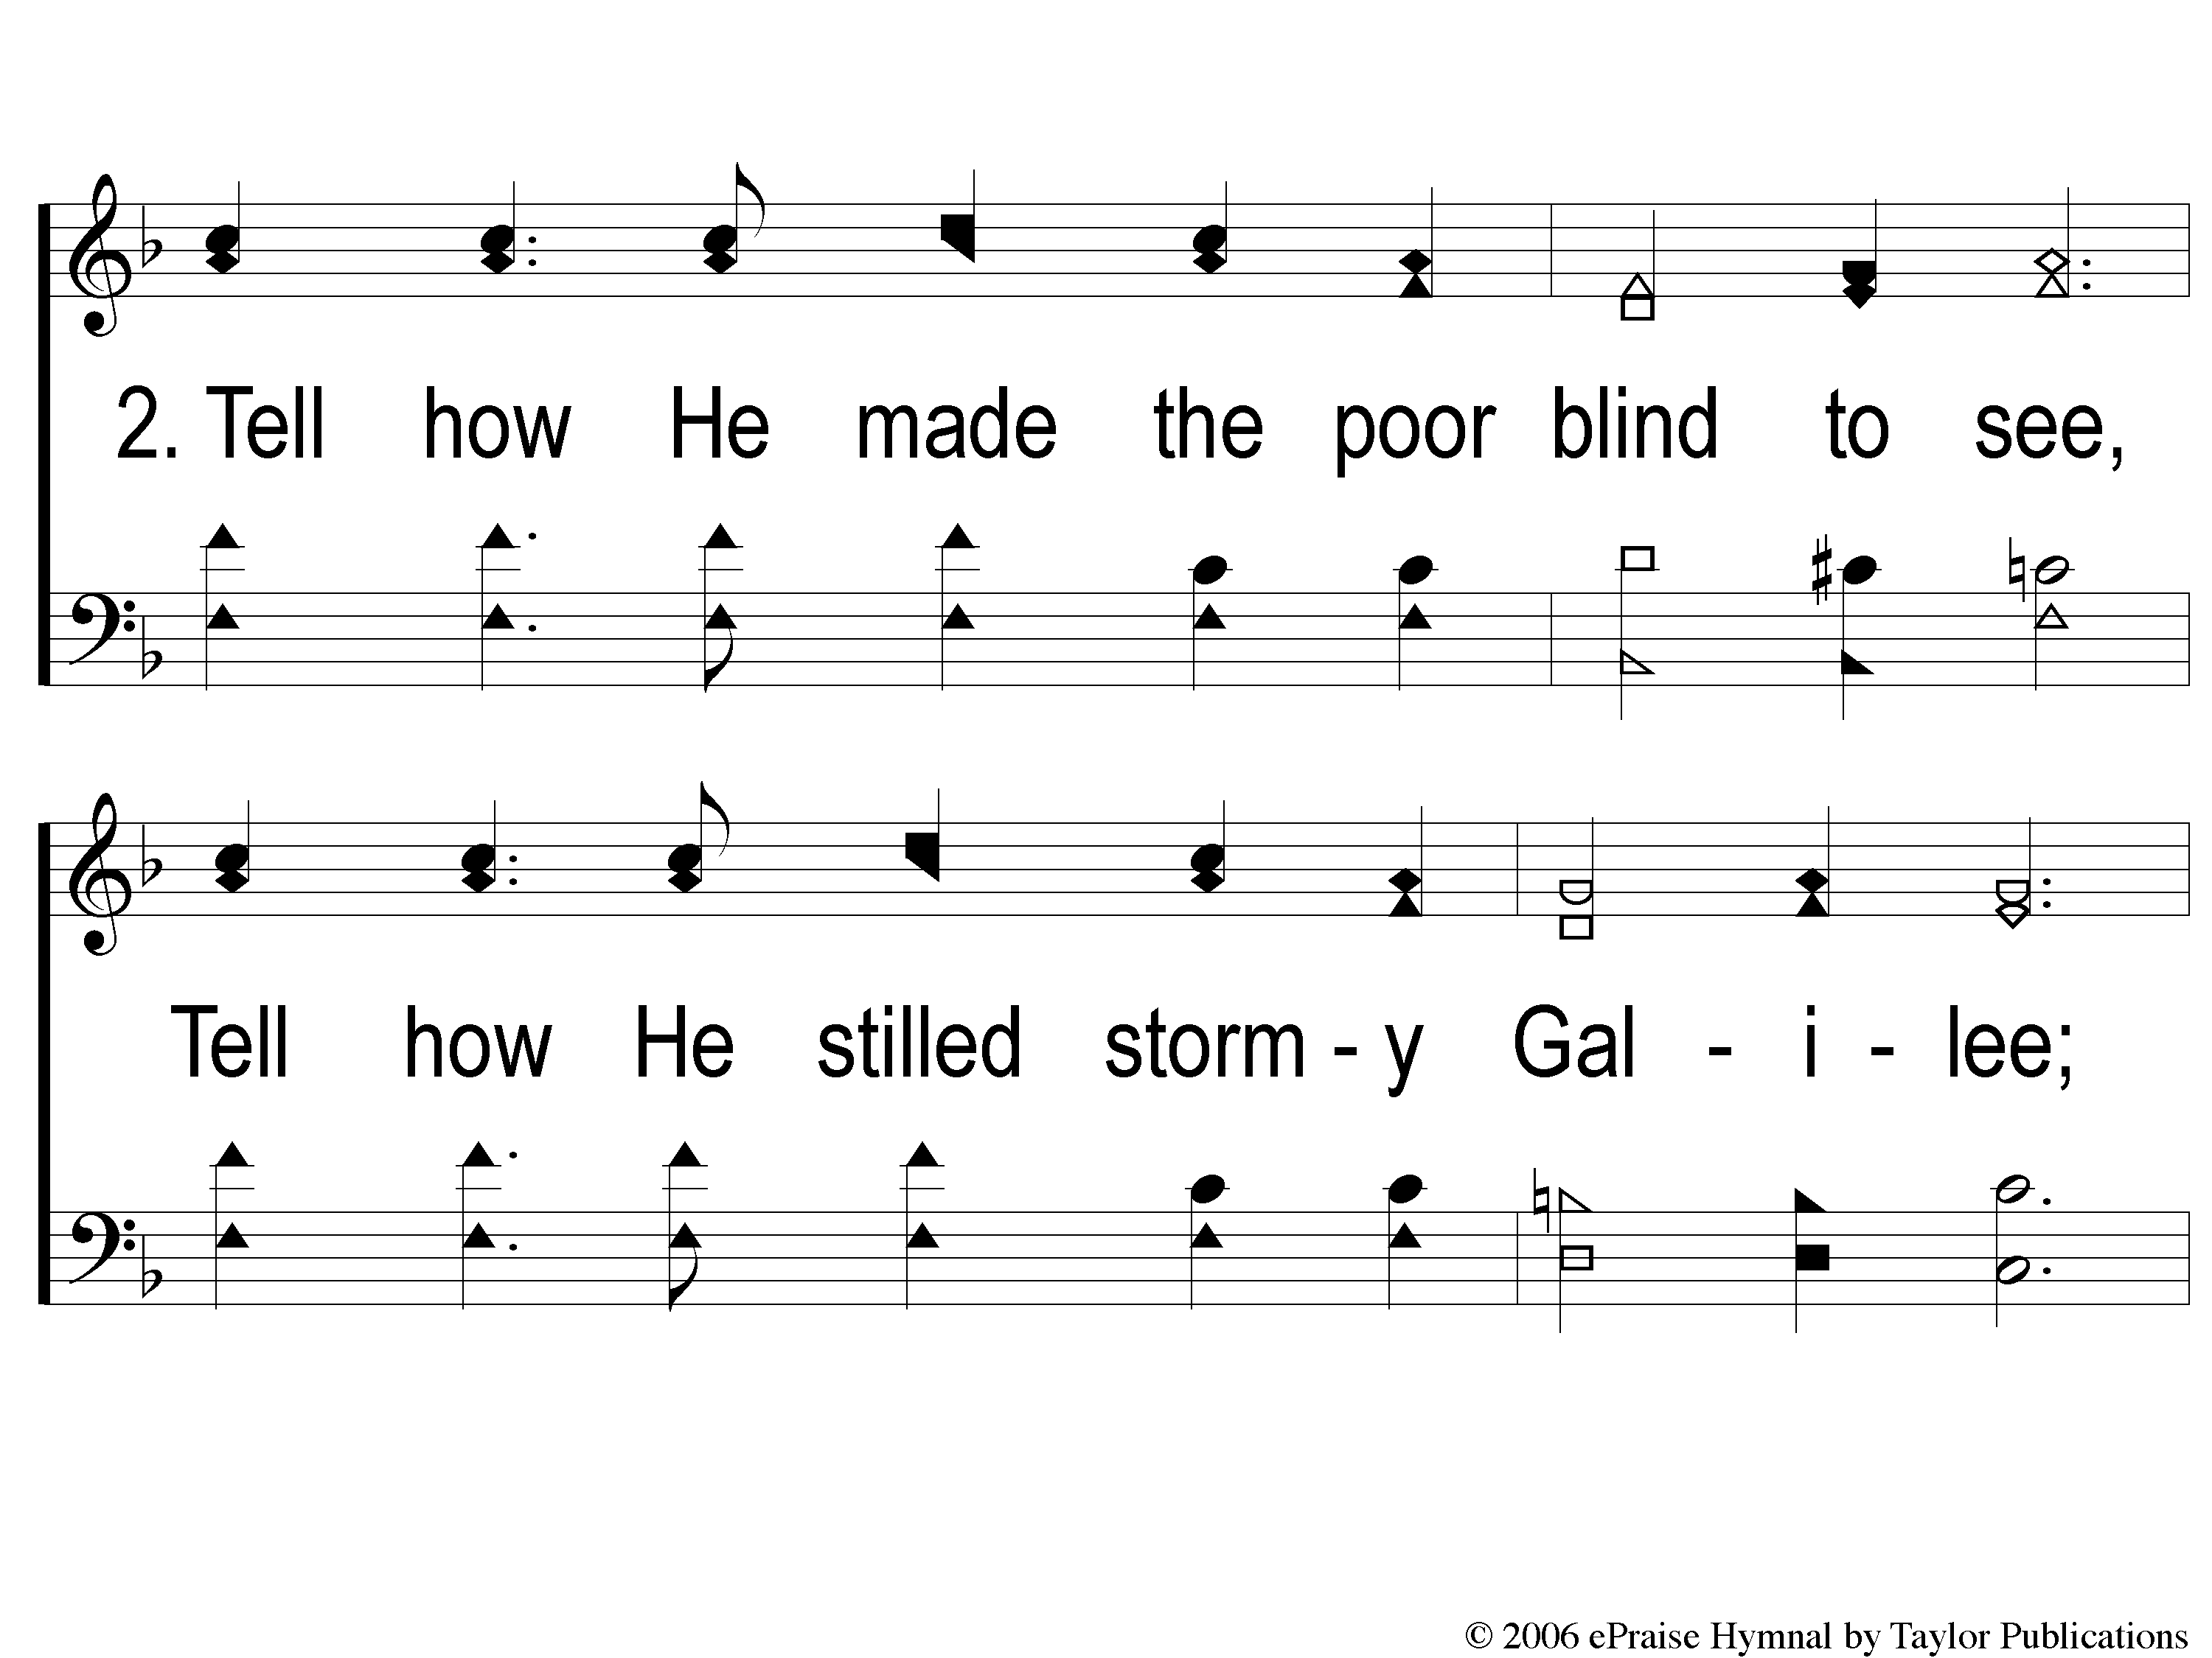
2-1 Tell Them of Jesus
Tell Them of Jesus
1a

Slide 6
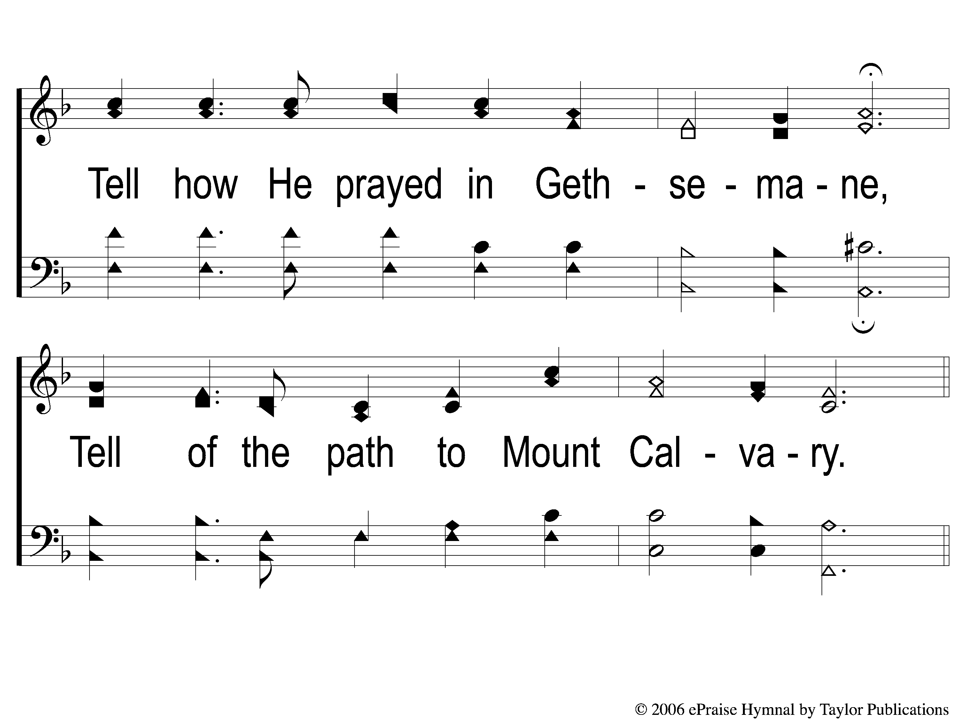
2-2 Tell Them of Jesus
Tell Them of Jesus
1a

Slide 7
C-1 Tell Them of Jesus
Tell Them of Jesus
1a

Slide 8
C-2 Tell Them of Jesus
Tell Them of Jesus
1a

Slide 9
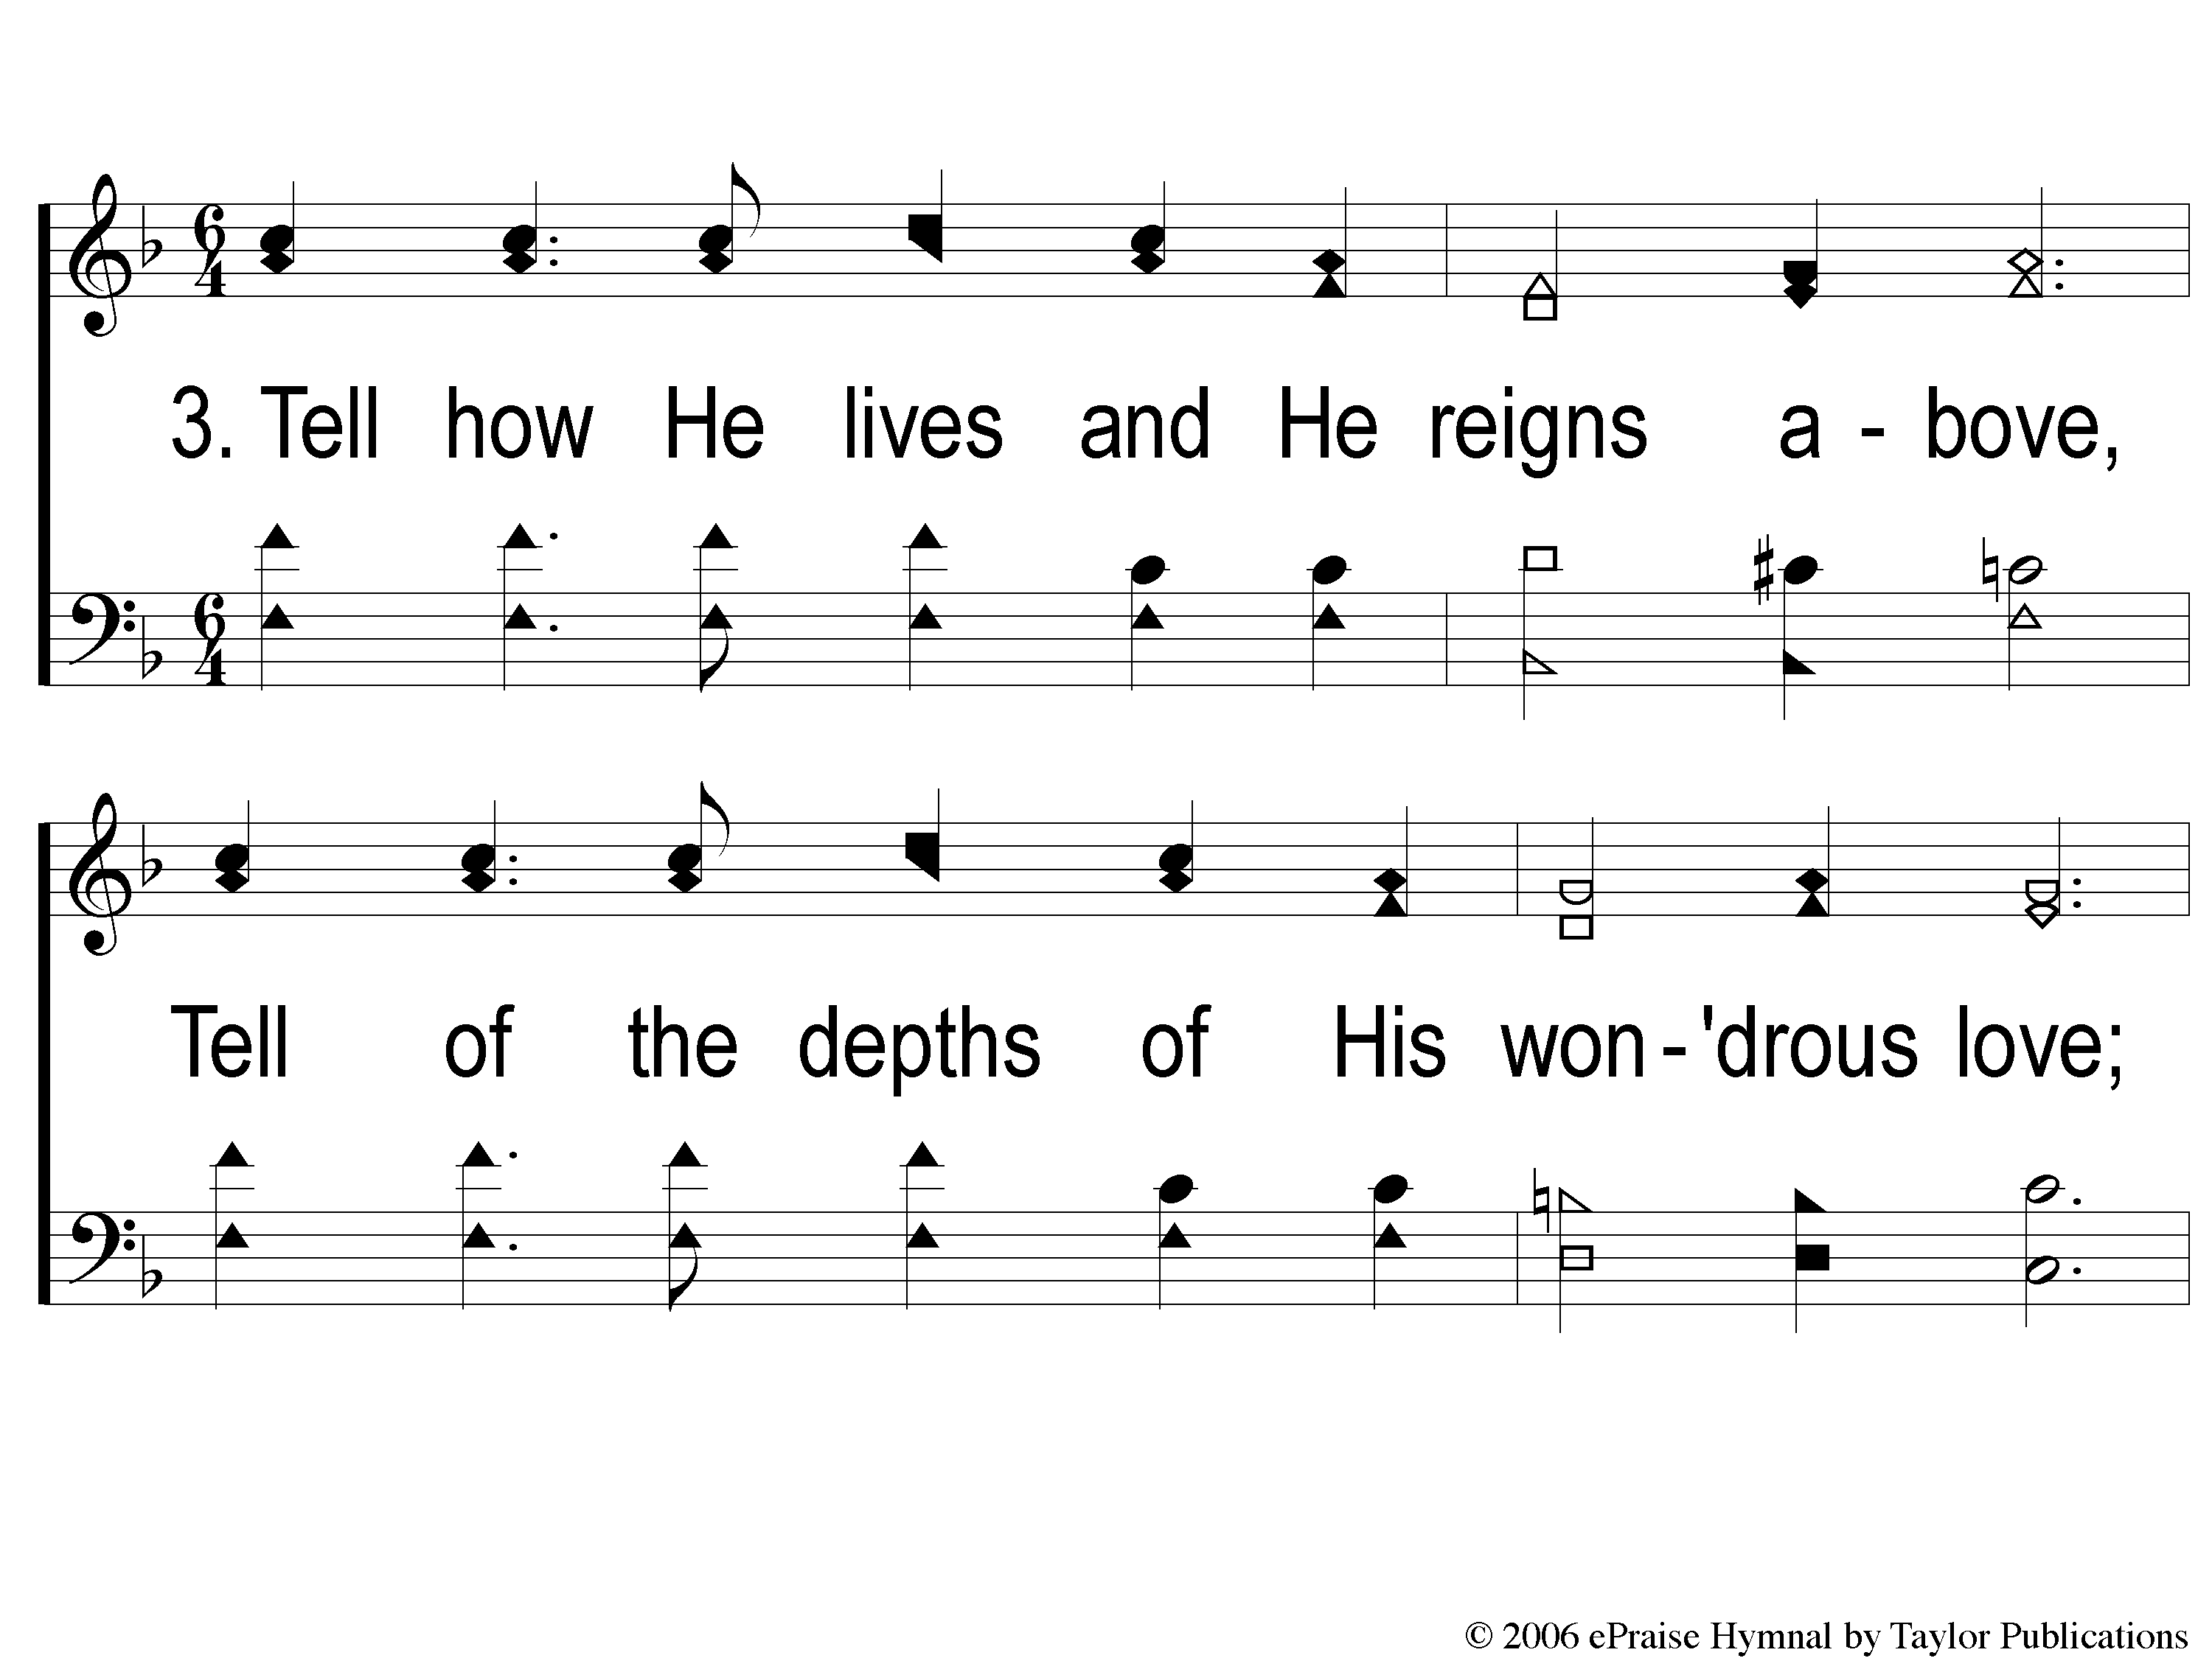
3-1 Tell Them of Jesus
Tell Them of Jesus
1a

Slide 10
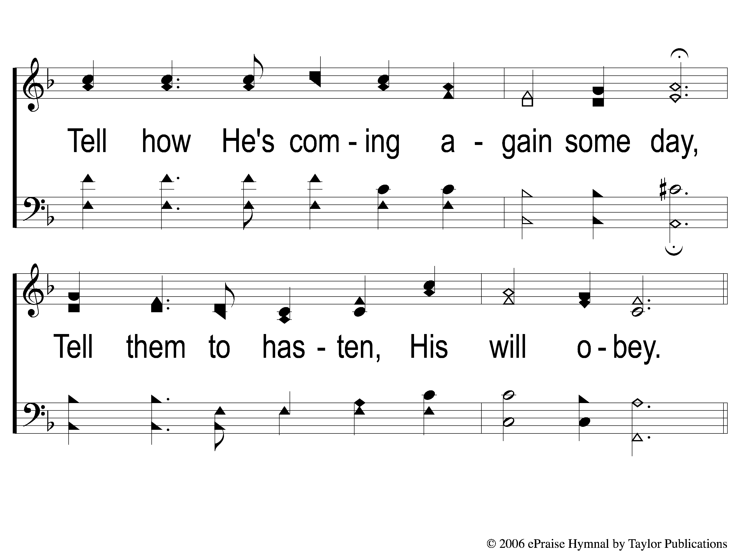
3-2 Tell Them of Jesus

Slide 11
C-1 Tell Them of Jesus
Tell Them of Jesus
1a

Slide 12
C-2 Tell Them of Jesus
Tell Them of Jesus
1a

Slide 13
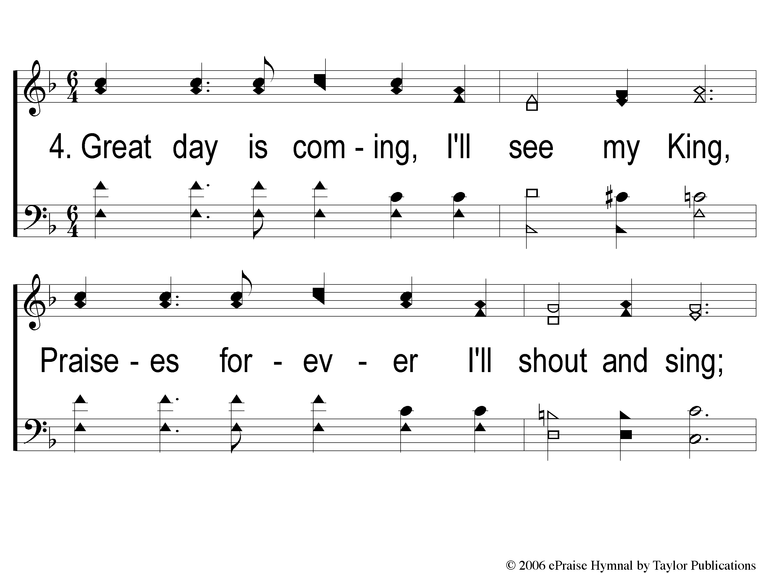
4-1 Tell Them of Jesus
Tell Them of Jesus
1a

Slide 14
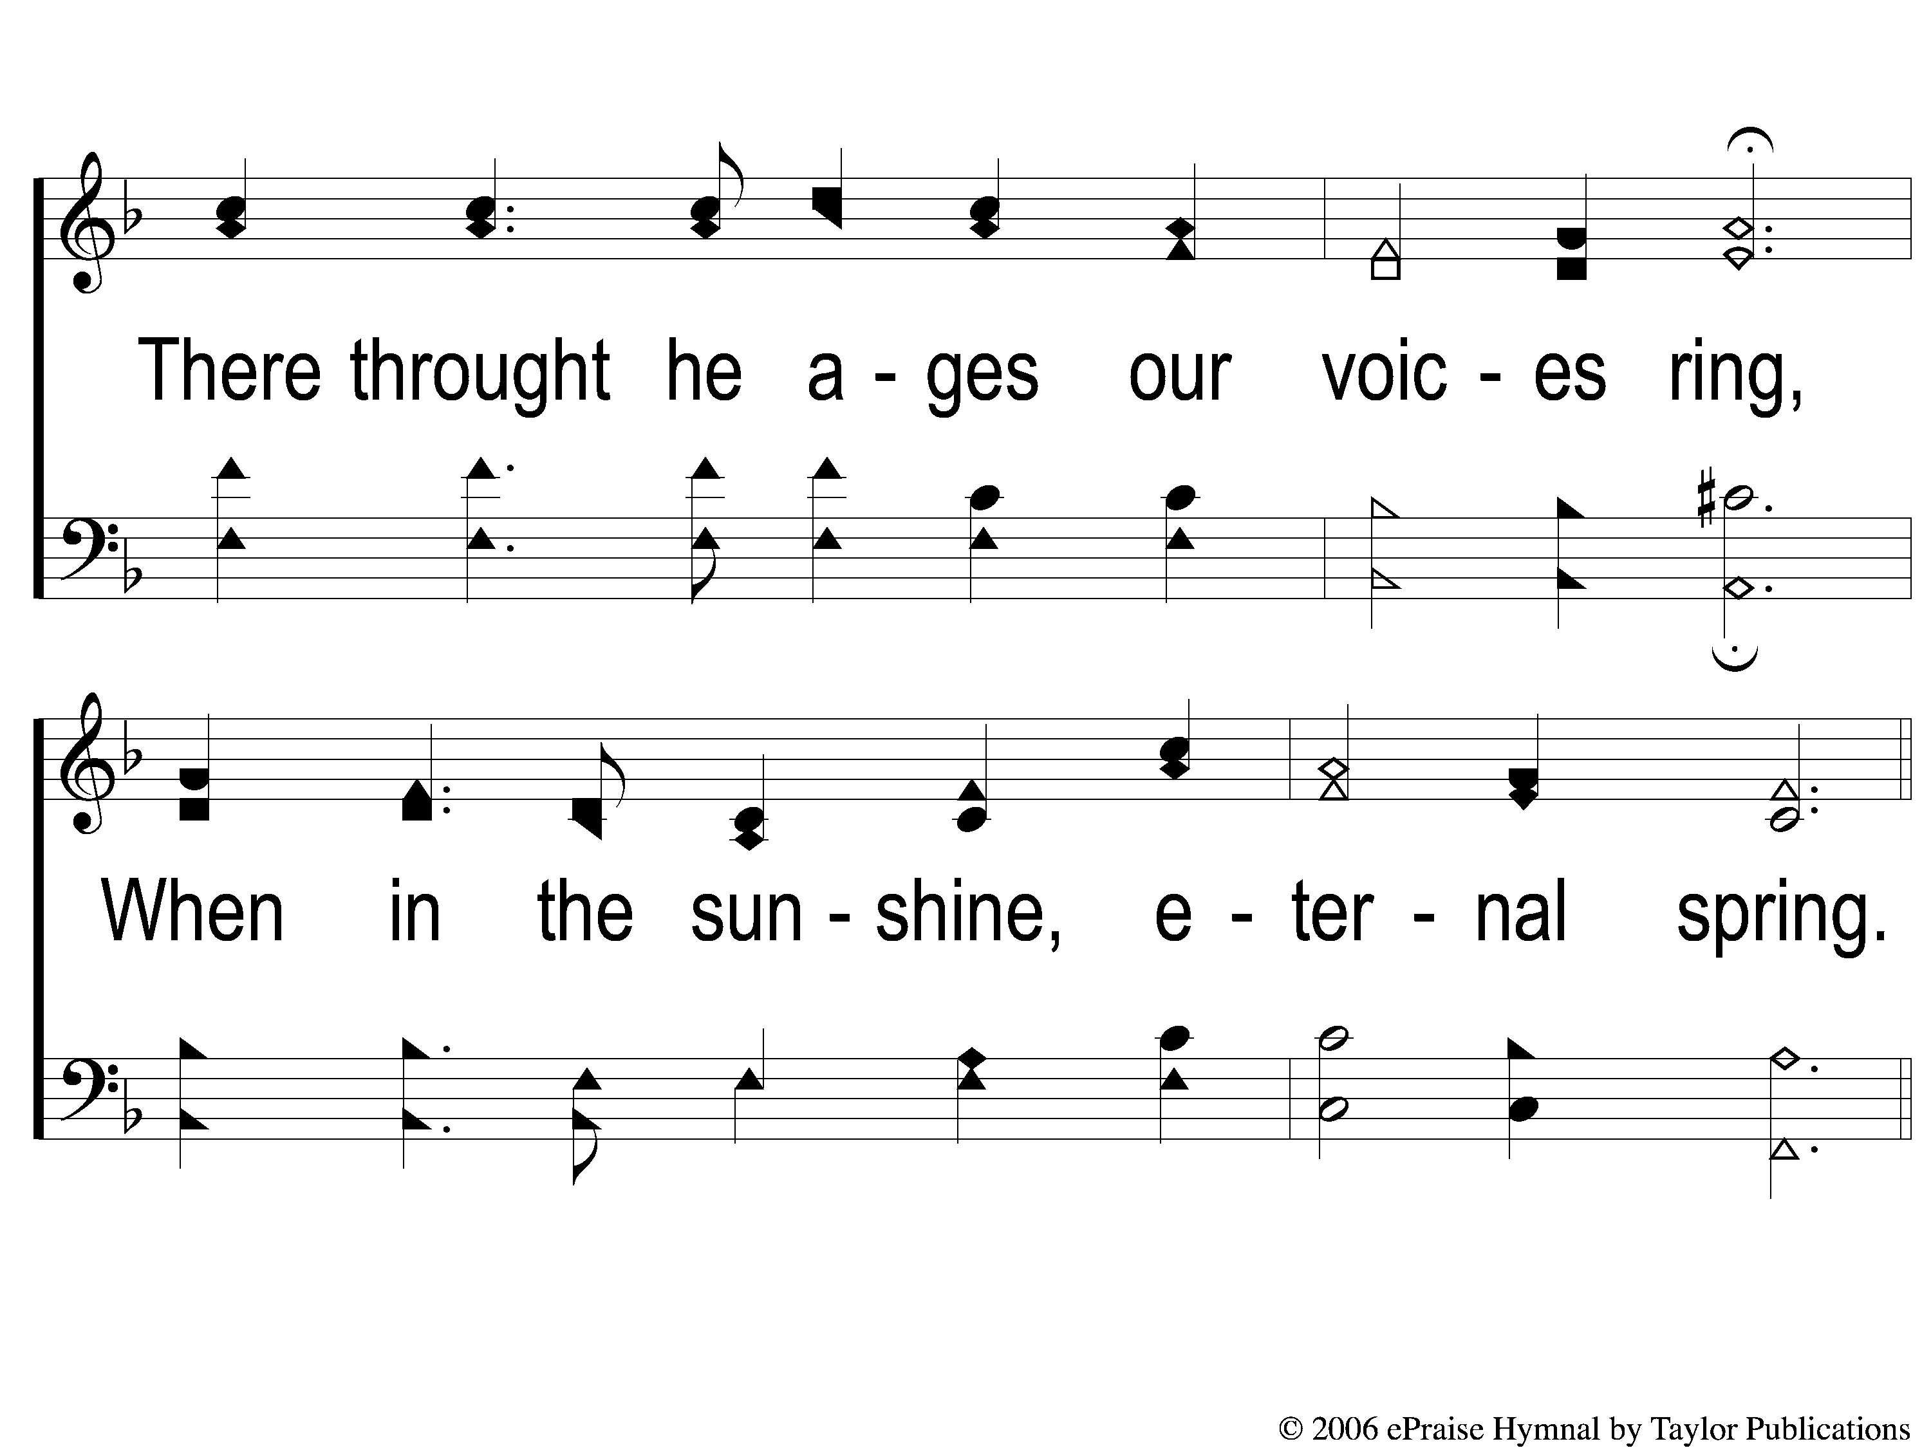
4-2 Tell Them of Jesus
Tell Them of Jesus
1a

Slide 15
C-1 Tell Them of Jesus
Tell Them of Jesus
1a

Slide 16
C-2 Tell Them of Jesus
Tell Them of Jesus
1a

